Slide 1
AUTONOMOUS MOBILE ROBOT
Dineshkumar S | Vishal A

Slide 2
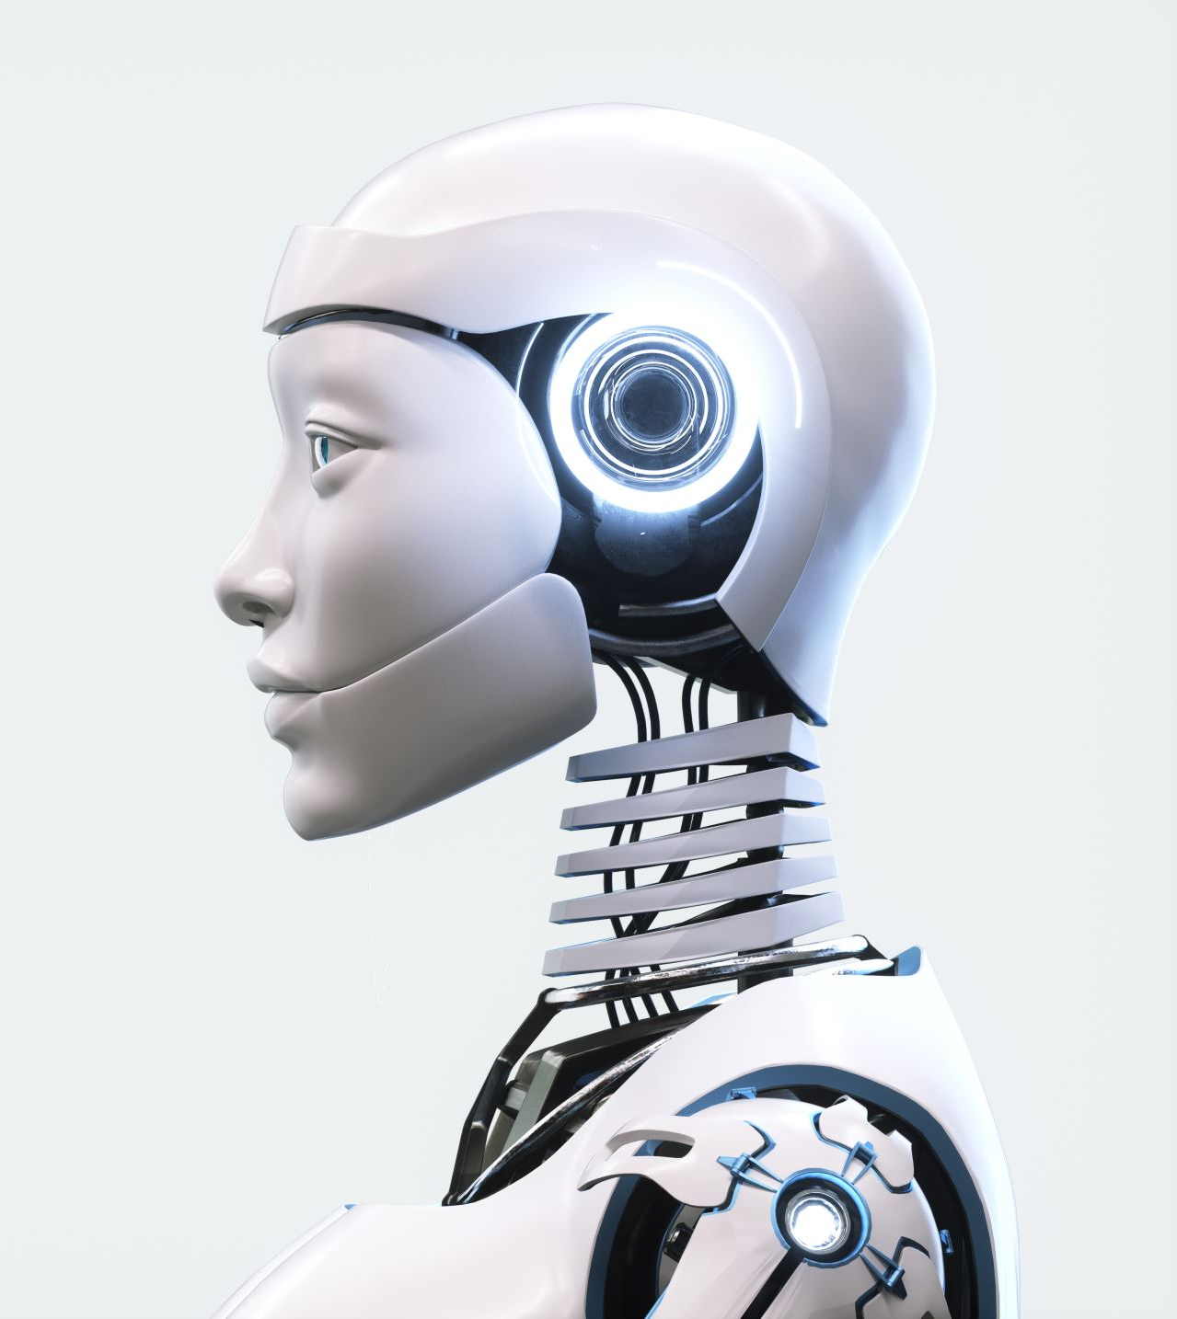
Autonomous Mobile Robot
An autonomous mobile robot (AMR) is any robot that can understand and move through its environment without being overseen directly by an operator.
Typically, this is achieved through an array of sophisticated on-board sensors, computers, and maps, which allow AMRs to understand and interpret their environment in order to function as a form of asynchronous transportation.

Slide 3
Why Autonomous Mobile Robots?
Enhanced Safety for Workers: Many businesses use AMRs for tasks that would be harmful to or not possible for human workers.
Increased Flexibility: AMRs dynamically assess and respond to their surroundings while completing a variety of tasks—all without the direct supervision of an operator. Simultaneous location and mapping (SLAM) solutions and advanced mapping technology enable AMRs to understand and adjust to changes in their environment. This flexibility makes them a valuable tool that can be used across applications and industries.
Improved Efficiency and Productivity: To enable employees to focus on high-value activities, such as customer support, businesses often use AMRs to assist with locating, picking, and moving inventory.

Slide 4
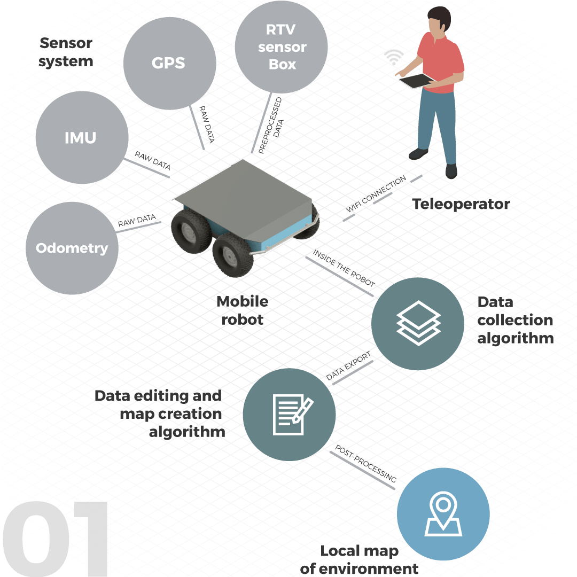
Main Blocks of AMR
Perception
Decision
Actuation

Slide 5
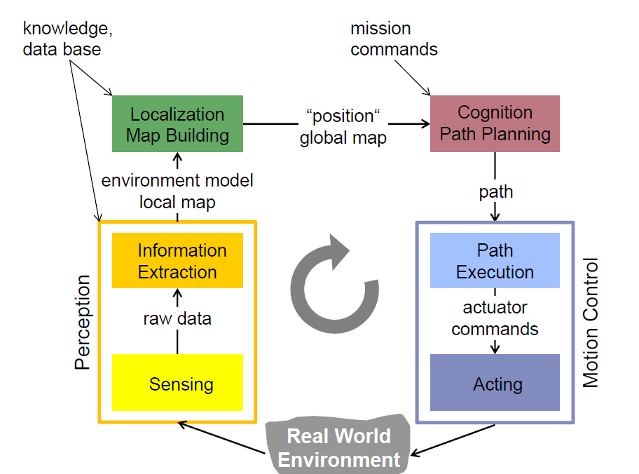
Mobile Robot Control Block

Slide 6
Locomotion
The robot’s locomotion system is an important aspect of the mobile robot design, and it depends not only on the medium in which the robot moves but also on technical criteria such as maneuverability, controllability, terrain conditions, efficiency, stability, and so on.

Slide 7
Classification of Locomotion
According to their locomotion system, mobile robots can be classified into:
1. Stationary (arm/manipulator)
2. Land-based
3. Air-based
4. Water-based
5. Other

Slide 8
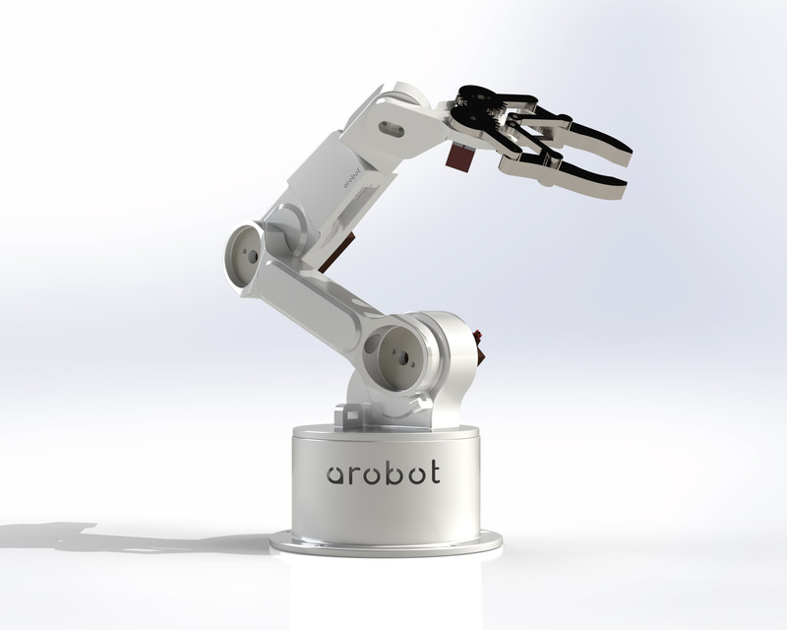
1. Stationary robots
The robot’s base is fixed, and they consist of an end-effector with specials tools which not only handle objects but can also perform tasks such as welding, painting, assembling, machining, and so on.

Slide 9
2. Land Based Robots
These robots are classified as below:
a. Wheeled mobile robot (WMR)
b. Walking (or legged) mobile robot
c. Tracked slip/skid locomotion
d. Hybrid

Slide 10
a. Wheeled Mobile Robots
Wheels are one of the most important systems for robot locomotion, the use of wheels is simpler than using treads or legs and is easier to design, build, and program when the robot is moving on flat, nonrugged terrain.
They also tend to be much cheaper than their legged counterparts. Wheel control is less complex, and they cause less wear and tear on the surface where they move in comparison with other solutions.
Another advantage is that they do not present any great difficulty in terms of balance issues, since the robot is usually in contact with a surface.

Slide 11
It is very important when modeling any robot to know the number and types of wheels. According to the number of wheels, the robots can be classified as follows :
Single-wheeled robots: Unicycle robots have only one fixed or conventional wheel. The unicycle system is an inherently unstable system. Both longitudinal and lateral stability controls are needed simultaneously to maintain the unicycle’s posture.
Two-wheeled robots: These have two alike parallel, conventional wheels (linked to both sides of the robot), which are controlled by two independent actuators. It is also considered that every wheel is perpendicular to the ground and the contact between the wheels and the ground is nonskipping and pure rolling.
Three-wheeled robots: Two types of three-wheeled robots can be distinguished: firstly, differentially steered (two driven wheels with an additional free turning wheel to maintain the vehicle in balance) and secondly, two wheels driven by a single actuator and a driven steering for the third wheel

Slide 12
Four-wheeled robots: These robots are more stable than the three-wheeled counterpart, because the center of gravity (COG) is located inside the rectangle formed by the four wheels rather than a triangle. The wheels can be differentially steered (like rovers), two-by-two powered wheels (like a tank motion) or can have car-like steering.
Five-wheeled robots: Five-wheeled robots are designed to move through outdoor rough terrains since they improve the contact and stability. A solution was proposed on innovative asymmetrical prototype of a five wheeled robot with reconfiguration features which can over cross the obstacles and climb on slope.
Six-wheeled robots: When more powered wheels are used, the design becomes much more complex. These six wheeled robots should have a suspension system which keeps all six wheels in contact with the surface and helps them go over slopes and sandy terrain. Good control is needed to avoid slipping.

Slide 13
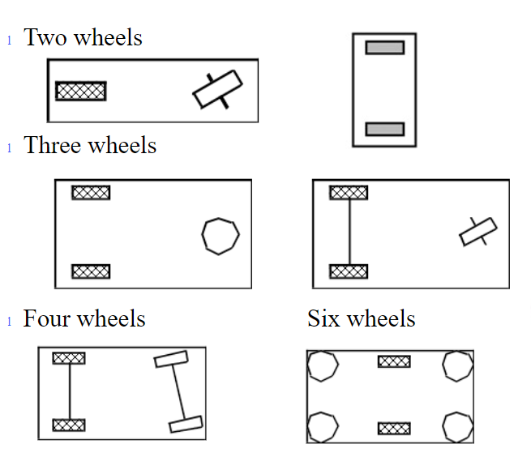

Slide 14
Wheel Design
Fixed standard wheel: These are conventional wheels with one degree of freedom (DOF), rotation around the contact point.
Castor wheel: It has two DOF and turning around an offset steering joint.
Swedish wheel: It has three DOF, revolving around the driven wheel axle, around the contact point and the rollers.
Ball or spherical wheel: Its implementation is technically complex.

Slide 15
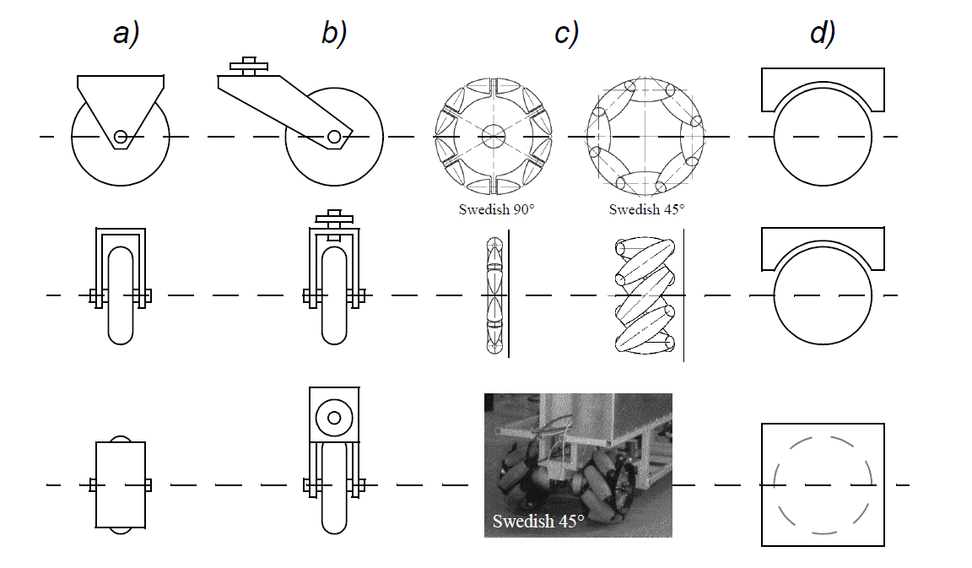
Wheel Design

Slide 16
b. Walking or legged mobile robots
Legs are another common form of locomotion, giving rise to walking robots. Although they are usually more expensive than wheels, legs have several advantages over wheels. The greatest advantage is their transversality and efficiency and the fact that they can also move on soft and uneven terrain, better mobility, better energy efficiency, better stability, and a smaller impact on the ground.
There are many types of walking robots depending on the number of legs. Among the most important are biped (humanoids), four-legged (quadruped), six-legged.

Slide 17
One-legged robot: “Hoppers” are one-legged robots. The greatest challenge with hoppers is that they cannot stand still; they need to keep hopping in order to maintain their balance.
Two-legged or humanoid robots: One of the most important types of walking robots is humanoid robots. In order to 4 International Journal of Advanced Robotic Systems reproduce human capabilities, they make good use of sensors.
Three-legged robots: These are not very common because of the odd number of legs. In the course of a step, two legs behave as supportive legs while the other works as a swing leg. The aim of the legs is to push the COG outside of the supportive legs to start a step. While the robot´s body falls forward, the swing leg naturally swings in between the two supportive legs and catches the fall.
Four-legged (quadruped) robots: When increased safety or payload capability is needed, quadrupeds or robots with a larger number of legs are used. They have the advantage of being statically stable when not moving, but they require dynamic walking control, as the robot’s COG must be readily shifted during gait. The control and leg coordination of these larger robots is, however, more complicated. These systems require a high computational speed. The motors and power storage system required for these systems are highly expensive.
Five-legged (quadruped) robots: This kind of robots are rarely developed due to the odd number of legs. A five-legged robot inspired from starfish.
Six-legged (hexapod) robots: A robot can be statically stable on three or more legs, so a robot with six or more legs can be controlled with static walking techniques rather than dynamic walking, thus reducing the control complexity. A common architecture for walking robots is the hexapod. These kind of robots have been very popular in mobile robotics.

Slide 18
Four Legged
Two Legged
Six Legged
One Legged

Slide 19
c. Tracked robots
These are a type of robots that uses treads or caterpillar tracks instead of wheels. In the wheel configurations, we assume that wheels cannot skid against the surface. Other possible solution to steer, named skid/slip, might be used to redirect the robot by spinning wheels with the same direction at different speeds or in opposite directions.
Tracked robots have much larger ground contact patches, and this fact plays a major role to improve their maneuverability on loose surface in comparison to conventional wheeled robots.
The skid/slip steering is also a disadvantage of such configurations. Due to the great amount of skidding in the course of a turn, the exact robot´s COR is difficult to predict and the accurate change in position and direction is also subject to variation on account of the ground friction.

Slide 20
d. Hybrid robot
These are robots whose structure consists of a combination of any of the above-described types. Hybrid solutions combine the suitability of wheels with the adaptability of legs.
leg-wheel hybrid locomotion systems
leg-track hybrid locomotion systems
wheel-track hybrid locomotion systems
leg-wheel-track hybrid locomotion systems

Slide 21
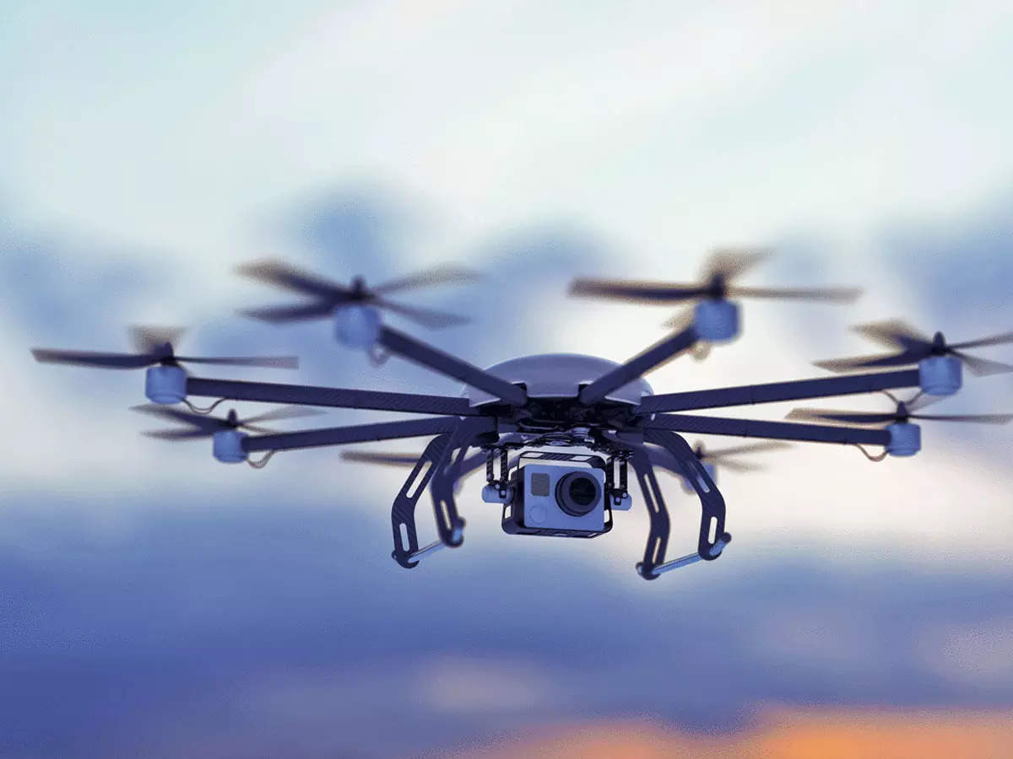
3. AIV-based robots
An unmanned aerial robot commonly known as “drone” is a machine that performs a preprogrammed task with or without human interaction and it is inspired by an airplane’s operation.
The most advanced ones can now take off and land completely independently of the actions of their operators.

Slide 22
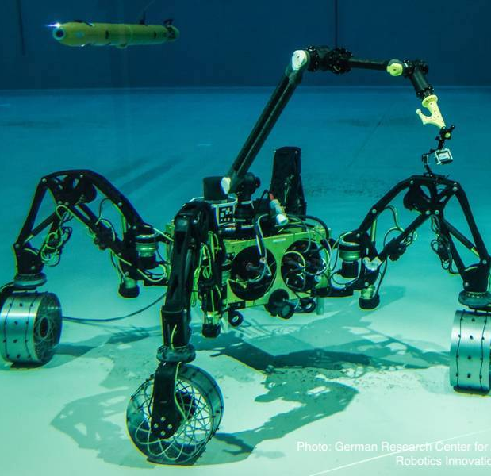
4. Water-based robots
As an important branch of mobile robots, the underwater vehicle manipulator system is one the hottest research topics nowadays.
Many devices have been built for this, including robotic systems. Ocean One is an example of a submarine robot. It is a humanoid robot that explores the seabed. It takes advantage of the best of remotely operated vehicles and the advantages of humanoid robots, such as having a robotic hand with which to rescue objects as if it were a human being.

Slide 23
5. Others
Snake-like robots: They are highly articulated robots that can coordinate their internal DOF to perform a variety of locomotion capabilities, thus extending the capabilities of conventional legged or wheeled robots. The main advantages of these robots are that they are versatile, achieving behaviors that are not bounded to climbing, crawling, and swimming.
Worm-like robots: These use peristalsis, the same method of locomotion that earthworms use This method of locomotion is particularly effective in constrained spaces. Other advantages are high deformability of the worm structure and high stability on irregular terrain, mobility, and in narrow regions. These robots could have various applications in medicine, including examination of the entire GI tract, as well as applications in search and rescue environments and military reconnaissance.

Slide 24
5. Others
Nanorobots: An emerging technology field creates robots whose components are at the scale of a nanometer. These robots allow precise interaction with nanoscale objects.
Cooperative robotics: It is concerned with the coordinated control of teams of robots.
Cooperative nanorobotics: It is concerned with the application to nanorobots (molecular level robots), with a difference in scale (small size, large numbers) and capabilities (self-replication).

Slide 25
Perception
It is vital for an autonomous mobile robot to acquire knowledge about its work environment and itself. This is achieved by means of sensors and subsequently extracting relevant information from those sensor’s measurements. The use of sensors makes it possible to perform robot positioning and localization tasks. They are also used for mapping and representation.

Slide 26
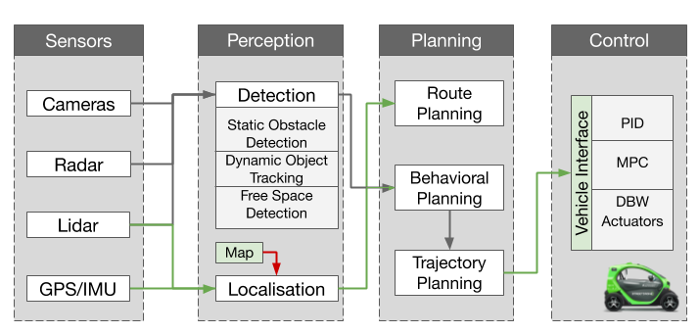

Slide 27
Sensor Classification
There are a great variety of sensors that can be used in a robot for data collection. They can be grouped into:
Proprioceptive sensors read values internal to the robot, such as motor speed, wheel load, joint angles, battery voltage, and so on. Exteroceptive sensors acquire information from the robot’s environment, such as distances, light intensity, and sound amplitude.
Passive sensors measure ambient environnemental energy entering the sensor, such as microphones, temperature probes, and Charge Coupled Device (CCD) or Complementary Metal Oxide Semiconductor (CMOS) cameras. Active sensors radiate energy into the surroundings and then measure the reaction.

Slide 28
Types of sensors
Tactile sensors: These are designed to sense objects at a small distance with or without direct contact and are used to detect physical contact or closeness. They are usually able to detect forces and can show the exact position of an object, allowing the robot to control the position and the grasping force of the end- effector.
Force torque sensors: The robot uses a force torque sensor to know what force the robot is applying. Different robot tasks such as assembly, handguiding, teaching, and force limitation can be performed with this device.
Encoders: To know the robot’s part position and speeds. There are a great variety such as optical encoders, potentiometers, resolvers, inductive encoders, magnetic encoders, capacitive encoders.
Infrared sensors: These are light-based sensors
Ultrasonic sensors: These are sound-based sensors and are used as distance meters. These sensors are designed to generate high-frequency sound waves and receive the echo reflected by the target.

Slide 29
Types of sensors
Sonar: This can be used primarily for object detection. This sensor offers high performance on land and in water.
Active beacons: To help the robot navigate.
Accelerometers: To measure acceleration, from which velocity can be obtained by integration. Humanoid robots use accelerometers
Gyroscopes: These are well-known and reliable rotation sensors, which measure angular velocities and orientation
Laser range finder: This is a device which uses a laser beam to generate highly precise distance measurements. The distance between sensor and target is measured by calculating the speed of light and the time it takes for emitted light to return to the receiver.

Slide 30
Types of sensors
Vision-based sensors: These process data from any modality and use the electromagnetic spectrum to produce an image. The two current technologies for devising vision sensors are CCD and CMOS.
Color-tracking sensors: These make it possible to detect and track color in the environment
Contact and proximity sensors: To measure the force of contact with the environment.
Depth sensors: They are used in object detection, scene reconstruction, 3-D inspection, and so on. Two elements must always be present in a depth sensor: an infrared (IR) projector and an IR camera

Slide 31
Computer Vision Navigation for AMRs
Computer vision is a form of artificial intelligence (AI) in which software is programmed to help a computer, or in this case a mobile robot, “see,” analyze, and comprehend the content in its visual world. Cameras are used to gather environmental data because of their wide field of view, high resolution, and ability to visualize colors.
When cameras are configured in pairs, it gives the AMR depth perception—seeing a three-dimensional view of the world just like humans do. With multiple pairs of cameras mounted on board, Palion AMRs have stereoscopic vision, seeing a three-dimensional environment, but with a more expansive field of view. Multiple camera pairs capture a 360° range of stereoscopic vision in front, behind, above, and next to the robot.

Slide 32
LiDAR Navigation for AMRs
LiDAR stands for “light detection and ranging.” This method uses a laser-based sensor and provides AMRs with a sense of spatial awareness. With LiDAR, lasers scan the surrounding environment, sending out pulses of laser light and timing how long it takes for the light to return to the sensor. It measures the amount of time it takes for the light to travel, calculating the exact distance to the object that is detected.
LiDAR is extremely precise. However, the precise view has limited visibility with low resolution, which often leads AMRs relying solely on LiDAR to fail in highly dynamic environments, like manufacturing, warehousing, and logistics facilities.

Slide 33
Sensor Fusion of LiDAR and Cameras
Instead of relying solely on cameras or LiDAR, AMRs take a hybrid, sensor fusion approach, taking advantage of the best of what cameras and LiDAR each have to offer.
To enhance the robot’s ability to perceive and understand its work, Seegrid’s algorithm leverages our advanced perception software, which fuses data from a combination of LiDAR sensors to enhance the robot’s situational awareness. These precise data points are collected and combined with vision-based data, providing the robots with even more information for an extremely accurate understanding of their immediate surroundings.

Slide 34
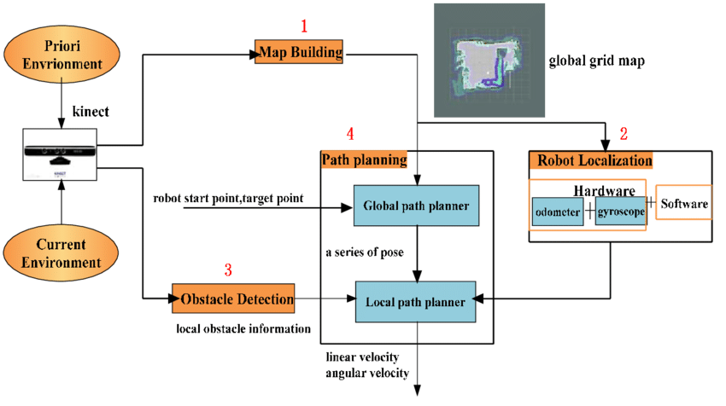

Slide 35
Cognition and control system
The mechanical structure of a mobile robot must be controlled to perform tasks and achieve its objectives.
The control system involves two different pillars:
Perception: The perception system gives information about the environment, the robot itself, and the relationship between robot and environment. This information is processed, then the appropriate commands are sent to the actuators, which move the mechanical structure.
Processing and Cognition: Based on the information from the sensors and the robot’s objectives, the cognition and control system must decide how to act and what to do to achieve its objectives.

Slide 36
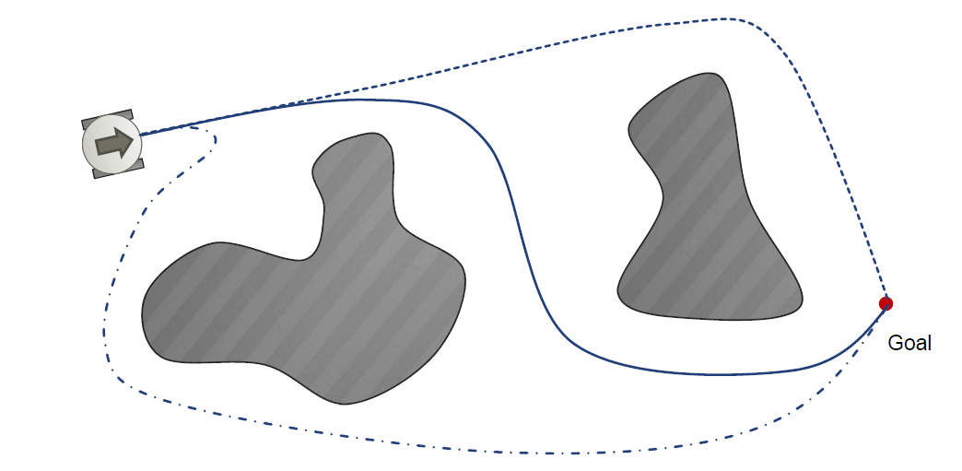
Where am I going? How to get there

Slide 37
Navigation
The most important aspect in the design of a mobile robot is navigation skills. The objective is for the robot to move from one place to another in a known or unknown environment, considering the values of the sensors to achieve the desired targets.
This means that the robot must rely on its other aspects, such as perception, localization, cognition, and motion control. Most of the time, the mobile robot cannot take the direct path from its initial position to the final goal, which means that motion planning techniques must be used.
Mobile robot navigation is categorized into the following tasks:
Generating a model of the world in the form of a map.
Computing a collision-free trajectory from a starting position to a target position.
Moving along the calculated trajectory, avoiding collision with obstacles.

Slide 38
Navigation Skill
It is essential to provide enough information about the robot’s location so that it can navigate. Therefore, localization techniques are key to the navigation process. Besides, additional skills are required for mobile robot navigation.
Trajectory planning: Given a map and an objective location, it involves obtaining the trajectory that the robot must follow in order to reach the objective location.
Obstacle avoidance: The data from the sensors may modulate the robot’s trajectory for avoiding collisions. The obstacle avoidance algorithms relies on the existence of a global map and on the robot’s accurate knowledge of its location in relation to the map.
In vision-based navigation, a robot is equipped with a local map and a path to follow. The relevant function of vision-based sensoring consists of “self-localization.” A robot is implemented with a series of images of the inner space. By comparing the camera images taken during navigation with the prerecorded images, the robot is capable out of finding its location.

Slide 39
Localization and mapping
Localization is closely related to representation. If an accurate GPS system could be installed on a robot, the localization problem would be solved. The robot would always know where it was.
But now, this system is not available or is not accurate enough to work with
localization implies not only knowing the robot’s absolute position on Earth but also its relative position with respect to a target.
Localization
"Position"
Cognition
Global Map
Environment Model
Path
Local Map
Perception
Real World
Motion Control
Environment

Slide 40
Localization Systems
Landmark-based navigation: Landmarks are generally defined as passive objects in the environment that provide a high degree of localization accuracy when they are within the robot’s field of view. Mobile robots that make use of landmarks for localization generally use artificial markers that have been placed by the robot’s designers to make localization easy.
Positioning beacon systems:One of the most reliable solutions to the localization problem is to design and deploy an active beacon system specifically for the target environment. This is the preferred technique used by both industry and military applications as a way of ensuring the highest possible reliability of localization. The GPS system can be considered as just such a system.
Route-based localization: Even more reliable than beacon-based systems are route-based localization strategies. In this case, the route of the robot is explicitly marked so that it can determine its position, not relative to some global coordinate frame but relative to the specific path it is allowed to travel. There are many techniques for marking such a route and the subsequent intersections.

Slide 41
Positioning
Exact knowledge of the position of a moving particle is a key issue in mobile robot applications
Techniques and technologies used for positioning are as follows:
1. odometry
2. inertial navigation
3. magnetic compasses
4. active beacons
5. global positioning systems
6. landmark navigation
7. model matching

Slide 42
Map Representation
The accuracy of the map should meet the accuracy, which the robot is working with. The precision of the map must also meet the accuracy and data kinds returned by the robot’s sensors. And it is important to remember that the complexity of the map representation influences the computational complexity of reasoning about mapping, localization, and navigation.
Many map representation techniques have been used in path planning which are as follows:
1. Probabilistic map–based localization | 7. Positioning beacon systems
2. Markov localization | 8. Route-based localization
3. Kalman filter localization | 9. Autonomous map building
4. Monte Carlo localization | 10. The stochastic map technique
5. Landmark-based navigation | 11. Cyclic environments
6. Globally unique localization | 12. Dynamic environments

Slide 43
Path, trajectory, and motion planning
A*: This algorithm searches all possible paths to the target and identifies the one that has the smallest cost (shortest time, least distance travelled, etc.). From all the paths found, the algorithm selects the one or the ones that appear to lead most rapidly to the solution. A* works using weighted graphs: Starting from an initial node from a graph, it builds a tree of paths starting from that node, exploring the possible paths one step at a time, until one of its paths ends at the targeted node.
Greedy search: This technique solves problems by searching for the locally optimal choice at each stage trying to find a global optimum. Usually, a greedy search algorithm does not produce the best solution, but nonetheless a greedy heuristic might produce locally optimal solutions that approximate a global optimal solution in the quickest possible time

Slide 44
Path, trajectory, and motion planning
Dijkstra’s algorithm: This is an algorithm for finding the shortest paths between nodes in a graph, which may represent, for example, roadmaps or a discretized workspace.
D*: This technique determines a path starting from the goal and working back to the start using a slightly modified Dijkstra’s search.
These methods can guarantee completeness, efficiency, and optimality and can find a path faster than the classical ones

Slide 45
Autonomous Map Building
Starting from the arbitrary initial point, a mobile robot should be able to autonomously explore the environment with its on board sensors to gain knowledge about it, interpret the scene, build an appropriate map and localize itself relative to this map.
Autonomous map building can be achieved using SLAM(simultaneous localization and mapping)
SLAM is central to a range of indoor, outdoor, air and underwater applications for both manned and autonomous vehicles.

Slide 46
Obstacle avoidance
Collisions between the mobile robot and obstacles must be avoided during robot motion. Robot navigation is related to a mobile robot’s ability to move around the environment (known or unknown) to achieve a goal without hitting any obstacles.
The robot’s motion from its current location to the goal involves calculating a trajectory. The process needs a map, a goal location, and the robot’s current location using sensors or another location system. In addition, a good motion planner must be able to detect collisions between the robot and obstacles in the work environment so that the robot can change its trajectory or stop before a collision occurs.

Slide 47
The Algorithms to Prevent Collisions
Map-based: These algorithms depend on geometric models or topological maps of the environment. The robot has a model of the environment. By knowing its current location at each moment, it can detect collisions by calculating distances. Methods for computing the distance between the robot’s current location and the nearest obstacle are the key to obstacle detection and can be grouped into four approaches: space-time volume intersection, swept volume interference, multiple interference detection, and trajectory parameterization.
Mapless-based: These use no explicit representation of the environment at all. They rely on sensor systems to observe the environment. Vector field histogram and the dynamic window approach are two algorithms that work well with 3-D and laser scanner sensors to avoid collisions.

Slide 48
Bug algorithm: In the bug algorithm, the main concept is to track the contour of the obstacles found in the robot’s path and circumnavigate it. There are a number of modifications and adaptations of the bug algorithm. One of the principal weaknesses of these kind of algorithms is that the robot’s behavior at each time is usually a function which only considers its most recent sensor readings.
Vector field histogram: This technique uses a 2-D histogram grid to model the environment, which is simplified to one dimension, the “polar histogram” built around the robot’s position at a certain instant. The sectors introduced in the polar histogram display the “polar obstacle density.” The guidance of the robot is monitored by selecting the sector with the smallest number of obstacles. The map modeled by the histogram grid is continuously renewed using the robot’s sensors with data related to the distance between the robot and obstacles.
Potential field methods: The mobile robot is considered as a particle that submerged in a potential field created by the target and by the obstacles alleged in the work environment. The target creates an attractive potential, while each obstacle creates a repulsive potential. The robot motion is interpreted as the motion of a particle in a gradient vector field created by positive and negative electric particles.

Slide 49
Industrial Application of AMRs
Manufacturing, Warehousing, and Logistics: Autonomous mobile robots are quickly becoming a valuable part of manufacturing, warehouses, and logistics businesses because of their versatility and ease of integration into existing infrastructures. They can be used to perform heavy- and light-duty tasks, deliver items to human employees, and carry out safety and security checks.
Healthcare: Healthcare providers rely on AMRs for critical needs such as disinfection, telepresence, and delivery of medication and medical supplies, creating safe environments for all while freeing up staff to spend more time with patients.
Retail, Banking, and Hospitality: Retailers, banks, and hospitality companies are using AMRs to streamline and enhance the customer experience—from customer service to inventory automation, room service, luggage assistance, and way finding.

Slide 50
Industrial Application of AMRs
Smart Cities and Public Sector: Innovative cities and government agencies across the globe are taking advantage of all AMRs have to offer. Smart cities are leveraging them to improve residential services, such as trash removal or public transportation, and public agencies are using AMRs for safety and security, search and rescue missions, and space exploration.
Agriculture: Agricultural companies are seeking the help of AMRs to overcome significant labor shortages, boost productivity, and improve yields.

Slide 51
MARKET STUDY ON AMRs

Slide 52
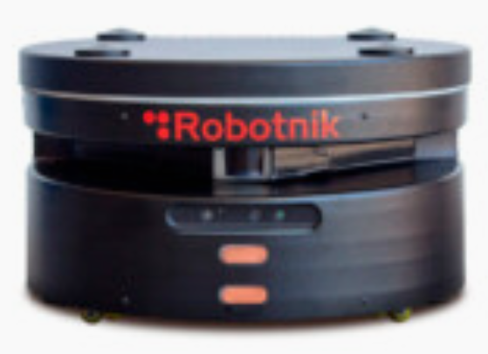
Robotnik – RB 1 Base Mobile Robot
Weight | 30Kg
Payload | 50Kg
Speed | 1,5 m/s
Environment | Indoor
Traction motor | 2 x 250 servomotors
Traction system | Differential drive
Controller | Open architecture ROS
Application | Logistics, Indoor Transportation

Slide 53
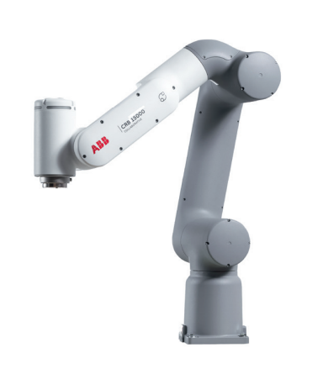
ABB – GoFa CRB 15000
Number of Axes | 6
Reach | 950
Protection | IP54
Controller | Omnicore C30
Weight | 28Kg
Payload | 5
Application | Material Handling, Machine tending, Assembly, Packing and Picking

Slide 54
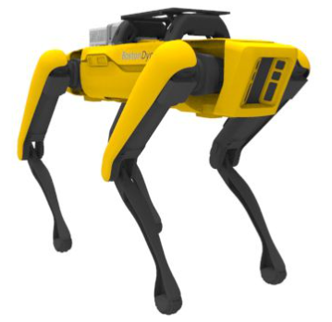
Boston Dynamics - SPOT
Weight | 32.5kg
Payload | 11kg
Max speed | 1.6 m/s
Run time | 90min
Drivers and apis | ROS kinetic, melodic, C++, python, rviz & URDF
Motherboard | I5 intel® 8th gen (whiskey Lake-u) core™ CCG lifecycle
Application | Construction, manufacturing, power & utilities, mining.

Slide 55
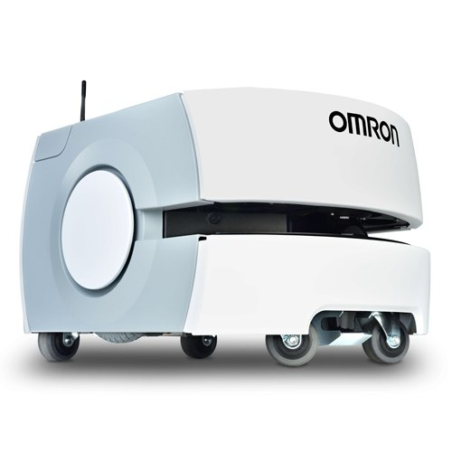
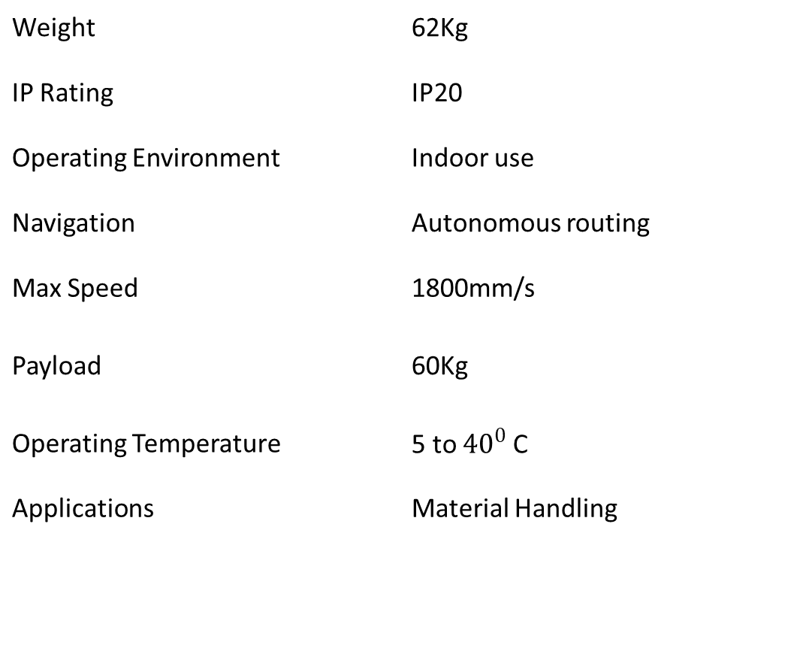
OMRON – LD - 60
Weight | 62Kg
IP Rating | IP20
Operating Environment | Indoor use
Navigation | Autonomous routing
Max Speed | 1800mm/s
Payload | 60Kg
Operating Temperature | 5 to ${40}^{0}$ C
Applications | Material Handling

